Slide 1
What’s next after computational genomics?

Slide 2
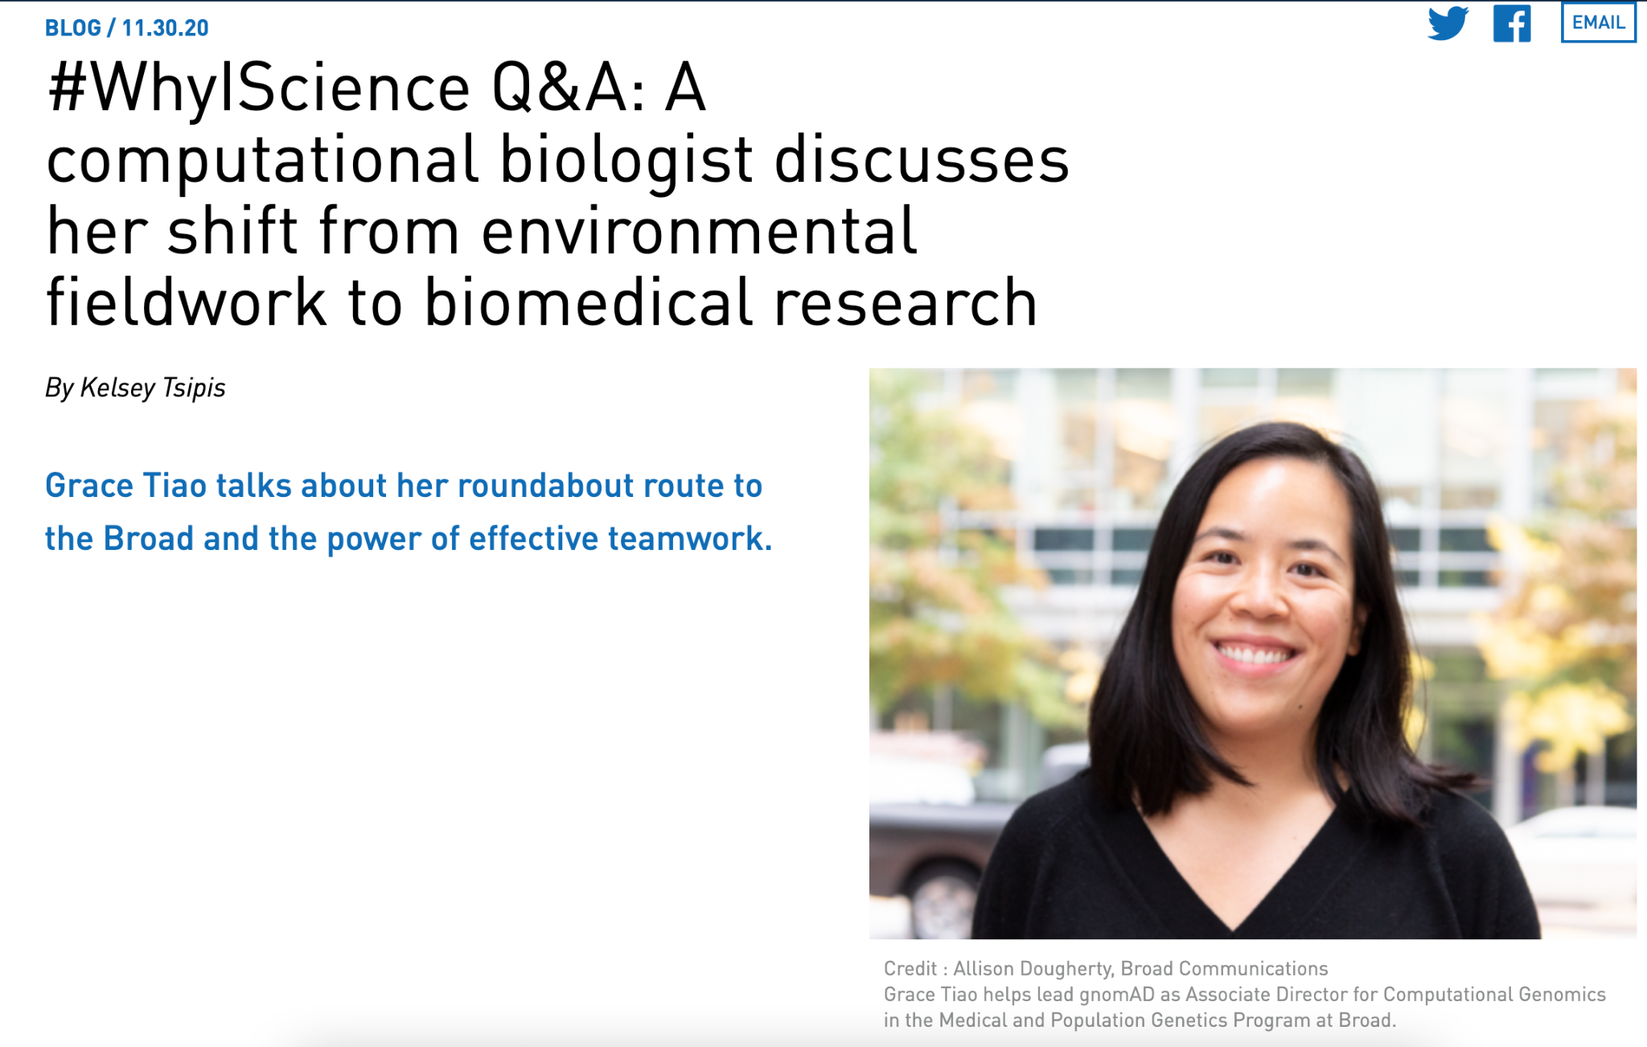
https://www.broadinstitute.org/blog/whyiscience-qa-computational-biologist-discusses-her-shift-environmental-fieldwork-biomedical
Notes:
https://www.broadinstitute.org/blog/whyiscience-qa-computational-biologist-discusses-her-shift-environmental-fieldwork-biomedical

Slide 3
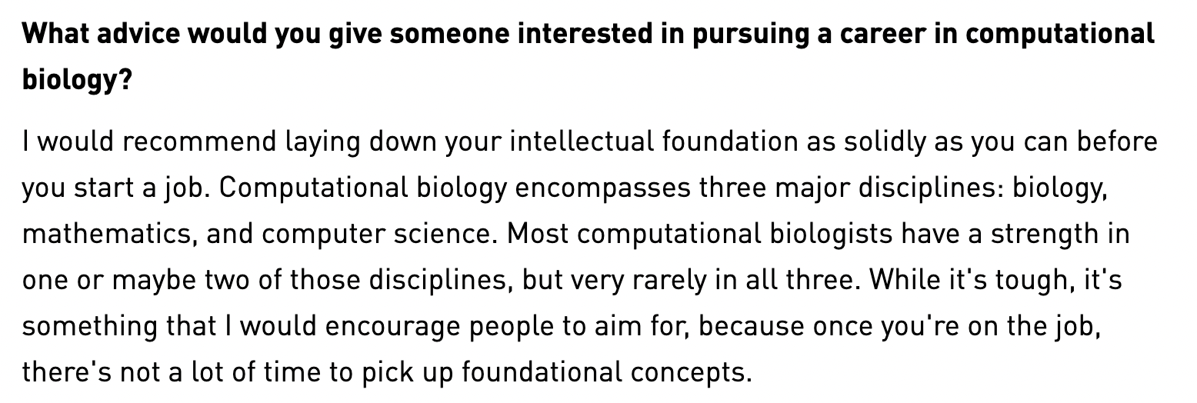
https://www.broadinstitute.org/blog/whyiscience-qa-computational-biologist-discusses-her-shift-environmental-fieldwork-biomedical
Notes:
https://www.broadinstitute.org/blog/whyiscience-qa-computational-biologist-discusses-her-shift-environmental-fieldwork-biomedical

Slide 4
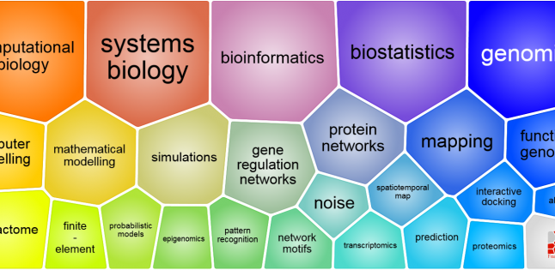

Slide 5
Computational biology depends on three fundamental disciplines
A fundamental understanding of biology
Now: What are driver gene mutations in cancer?
Need more background: What signalling pathways are responsible for cancer progression and metastasis?
Applications of computer science to biology
Now: How do I merge complex datasets?
Need more background: How do I align my sequences? How do I build a webapp to display data interactively?
Applications of statistics to biology
Now: How can I interpret a T-test?
Need more background: How do I deal with nonlinear data? How does differential gene expression analysis really work?

Slide 6
Computational biology depends on three fundamental disciplines
A fundamental understanding of biology
Molecular biology, genetics, cell biology, biochemistry
Applications of computer science to biology
Introduction to CS, data structures, algorithms, software development
Applications of statistics to biology
Multivariate calculus, linear algebra, probability, statistics, linear and generalized linear models, machine learning

Slide 7
Some interesting things
http://rosalind.info/
http://projecteuler.net/

